Slide 1
HNSciCloud Report
GDB 14.02.2018
Ben Jones

Slide 2
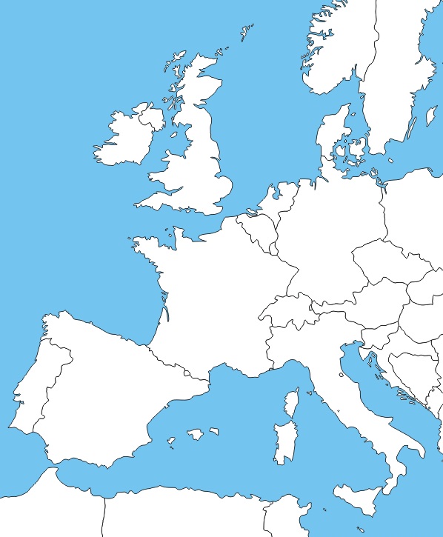










Helix Nebula Science Cloud Joint Pre-Commercial Procurement
Procurers: CERN, CNRS, DESY, EMBL-EBI, ESRF, IFAE, INFN, KIT, STFC, SURFSara
Experts: Trust-IT & EGI.eu
The group of procurers have committed
Procurement funds
Manpower for testing/evaluation
Use-cases with applications & data
In-house IT resources
Resulting services will be made available to end-users from many research communities
Co-funded via H2020 Grant Agreement 687614
Total procurement budget >5.3M€
Notes:
Research organisations from 7 countries have proposed to work together to develop a cross-border joint procurement of innovative cloud services. This is an important change: never before have research organisations across Europe pooled their funds and resources to procure cloud services to support their scientific programmes.
eduGAIN federated identity mgmt. should include commercial identity providers taking into account multiple levels of assurance.

Slide 3

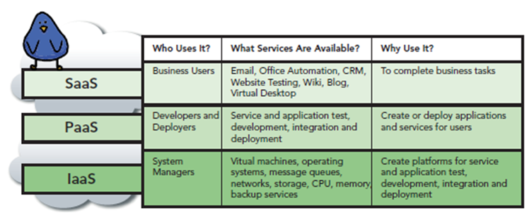



What is being procured
A hybrid cloud platform for the European research community
Combining services at the IaaS level to support science workflows
Source: CloudComputing for Govies, DLT Solutions, David Blankenhorn, Van Ristau and Caron Beesley
HNSciCloud PCP
The R&D services to be developed are to be integrated with Resources in data centres operated by the Buyers Group, GEANT network and eduGAIN fed. identity mgmt

Slide 4
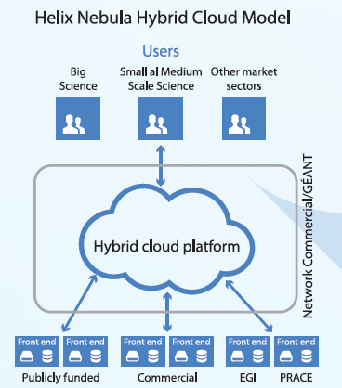
The Hybrid Cloud Model
Brings together
research organisations,
data providers,
publicly funded e-infrastructures,
commercial cloud service providers
In a hybrid cloud with procurement and governance approaches suitable for the dynamic cloud market
In-house

Slide 5
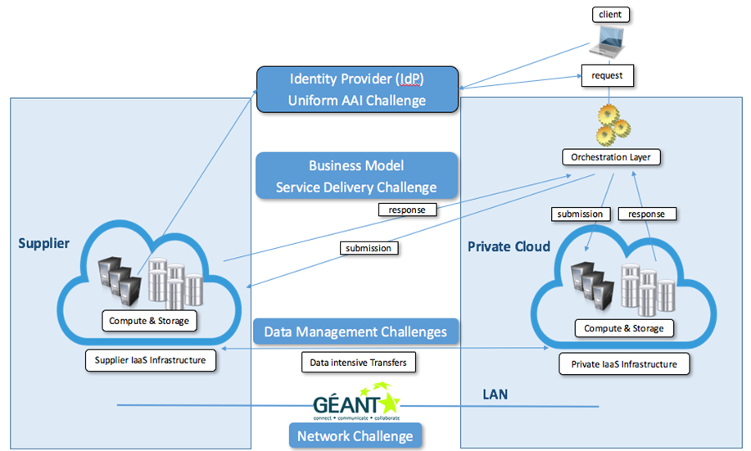
High Level Architecture of the Hybrid Cloud Platform including the R&D challenges
✓
Pilot phase
✓
✓

Slide 6
HNSciCloud project phases
We are here
Preparation
Analysis of requirements, current market offers and relevant standards
Implementation
Build stakeholder group
Develop tender material
and sharing
4 Designs
3 Prototypes
2 Pilots
Tender Jul’16
Call-off Feb’17
Call-off Dec’17
Jan’16
Dec’18
Each step is competitive - only contractors that successfully complete the previous step can bid in the next
Phases of the tender are defined by the Horizon 2020 Pre-Commercial Procurement financial instrument

Slide 7
Prototype phase lessons
IaaS resources PAYG would be more effective/flexible for this type of phase
Science v Industry cultural clash
Expected innovation – you have to ‘wish precisely’
No precise request: no activity/development
Requires focus on activity
Procurers report more time required vs expectation
85% tests completed: some storage tests pending

Slide 8
Prototype Vendors
 | IBM | T-Systems | RHEA
IAAS | IBM Cloud (previously “softlayer” and ”bluemix”) | T-Systems OTC | Multi Cloud Initially: OTC & Exoscale
Storage | IBM Spectrum Scale | One Data | One Data
AAI | ”HFM” HnSciCloud Frontend Manager SAML integration with IBM Identity management | SAML/ECP | Custom Keycloak / SAML bridge
Network | GEANT IAS | GEANT CloudVRF | GEANT CloudVRF

Slide 9
Pilot Vendors
 | IBM | T-Systems | RHEA
IAAS | IBM Cloud (previously “softlayer” and ”bluemix”) | T-Systems OTC | Multi Cloud Initially: OTC & Exoscale
Storage | IBM Spectrum Scale | One Data | One Data
AAI | ”HFM” HnSciCloud Frontend Manager SAML integration with IBM Identity management | SAML/ECP | Custom Keycloak / SAML bridge
Network | GEANT IAS | GEANT CloudVRF | GEANT CloudVRF

Slide 10
Pilot Vendors
 | IBM | T-Systems | RHEA
IAAS | IBM Cloud (previously “softlayer” and ”bluemix”) | T-Systems OTC | Multi Cloud OTC, Exoscale, Advania
Storage | IBM Spectrum Scale | One Data | One Data
AAI | ”HFM” HnSciCloud Frontend Manager SAML integration with IBM Identity management | SAML/ECP | Custom Keycloak / SAML bridge
Network | GEANT IAS | GEANT CloudVRF | GEANT CloudVRF
Addition of Advania to help solidify the multi-cloud offering. Advania have DC a based in Iceland, and apparently have additional HPC resources.

Slide 11
Pilot Vendors
 | IBM | T-Systems | RHEA
IAAS | IBM Cloud (previously “softlayer” and ”bluemix”) | T-Systems OTC | Multi Cloud OTC, Exoscale, Advania
Storage | IBM Spectrum Scale | One Data | One Data
AAI | ”HFM” HnSciCloud Frontend Manager SAML integration with IBM Identity management | SAML/ECP | Custom Keycloak / SAML bridge
Network | GEANT IAS | GEANT CloudVRF | GEANT CloudVRF
Both selected vendors use One Data for the data transparency layer

Slide 12
Multi Cloud solution
Value add of RHEA solution is the Nuvla / Slipstream API to abstract multiple clouds
In testing phase many members of Buyers Group used cloud tenancies directly
Addition of Advania to help show benefits of multi cloud approach
Current GEANT rules mean commercial <-> commercial traffic not allowed over VRF (ie OTC <-> Exoscale
Other options to abstract cloud (ie container engines)

Slide 13
One Data challenges
Testing of One Data (carried out by Daniele Spiga from INFN) has shown there are some performance challenges to address
Could not scale beyond 50 parallel client processes to One Data Provider at target cloud
Higher scale reported by developers
Possible usage pattern of Docker triggers the issues
Developers and Cloud providers engaged to resolve issue in next phase

Slide 14
Access to cloud service capacity
10k/
1PB
3 Prototypes
2 Pilots
We are here
5k/
500TB
3.5k/
350TB
2k/
200TB
Functional Testing
Scalability Testing
End User Access
100/
10TB
10Gbps
Call-off Dec’17
40Gbps
Cores/
Storage
WP6
Jun’17
Dec’17
Feb’18
Dec’18

Slide 15
Testing
Test suite expanded, all members of Buyers Group testing
Stress of One Data solution
Completion of Data Transparency tests from prototype phase
Focus on large scale, to test suitability of solution
Deployment of real workloads

Slide 16
CERN Tests – Pilot Phase
CERN Batch Service
Deployments from all the LHC experiments
Start with simulation, MC, RECO, then more intensive I/O, controlled analysis, ML workloads, Analysis trains…
Scale tests on federation of multiple container clusters
Storage
Data transfer speed tests and use of the data once transferred
Possible deployment of Dynafed: http://lcgdm.web.cern.ch/dynafed-dynamic-federation-project) on S3 (maybe of interest to INFN & STFC?)
Dockerised stack of services (EOS+CERNBOX+SWAN)
Potentially, Spark based HEP analysis (TOTEM experiment)
Security
Submission of jobs to be treated as malicious and test the monitoring, identification, traceability, logs, forensics evidence collection, etc.
Network
PerfSONAR @40Gbps (pending arrival of procured networking h/w @ CERN)
LHCb network-intensive workloads
GPUs (Machine Learning)
Distributed GAN training benchmarking for fast detector simulation
Deep Neural Networks and Conformal Prediction in Medical Applications

Slide 17
CERN: Summary
All the WLCG Experiments will deploy workloads on the HNSciCloud Pilots
Staged approach over the 3 ramp-up periods
Progressively more I/O intensive workloads will be deployed
Deployments progress to the next step if successful in the current one
Schedule will be weekly based
In case of deployment difficulties, other available workloads can be scheduled
Deployments will happen across the 2 pilots
Compute and Storage resources
As many as possible
Minimum will be provided to ensure the deployments have relevant results
GPUs: ideally tens to hundreds of nodes

Slide 18
Questions?

